Slide 1
Stakeholders Engagement in the Context of BRI for Promoting Responsible Business Conduct
Huang Zhong
Business and Human Rights Resource Centre

Slide 2
Two stories from the field study in Nepal

Slide 3
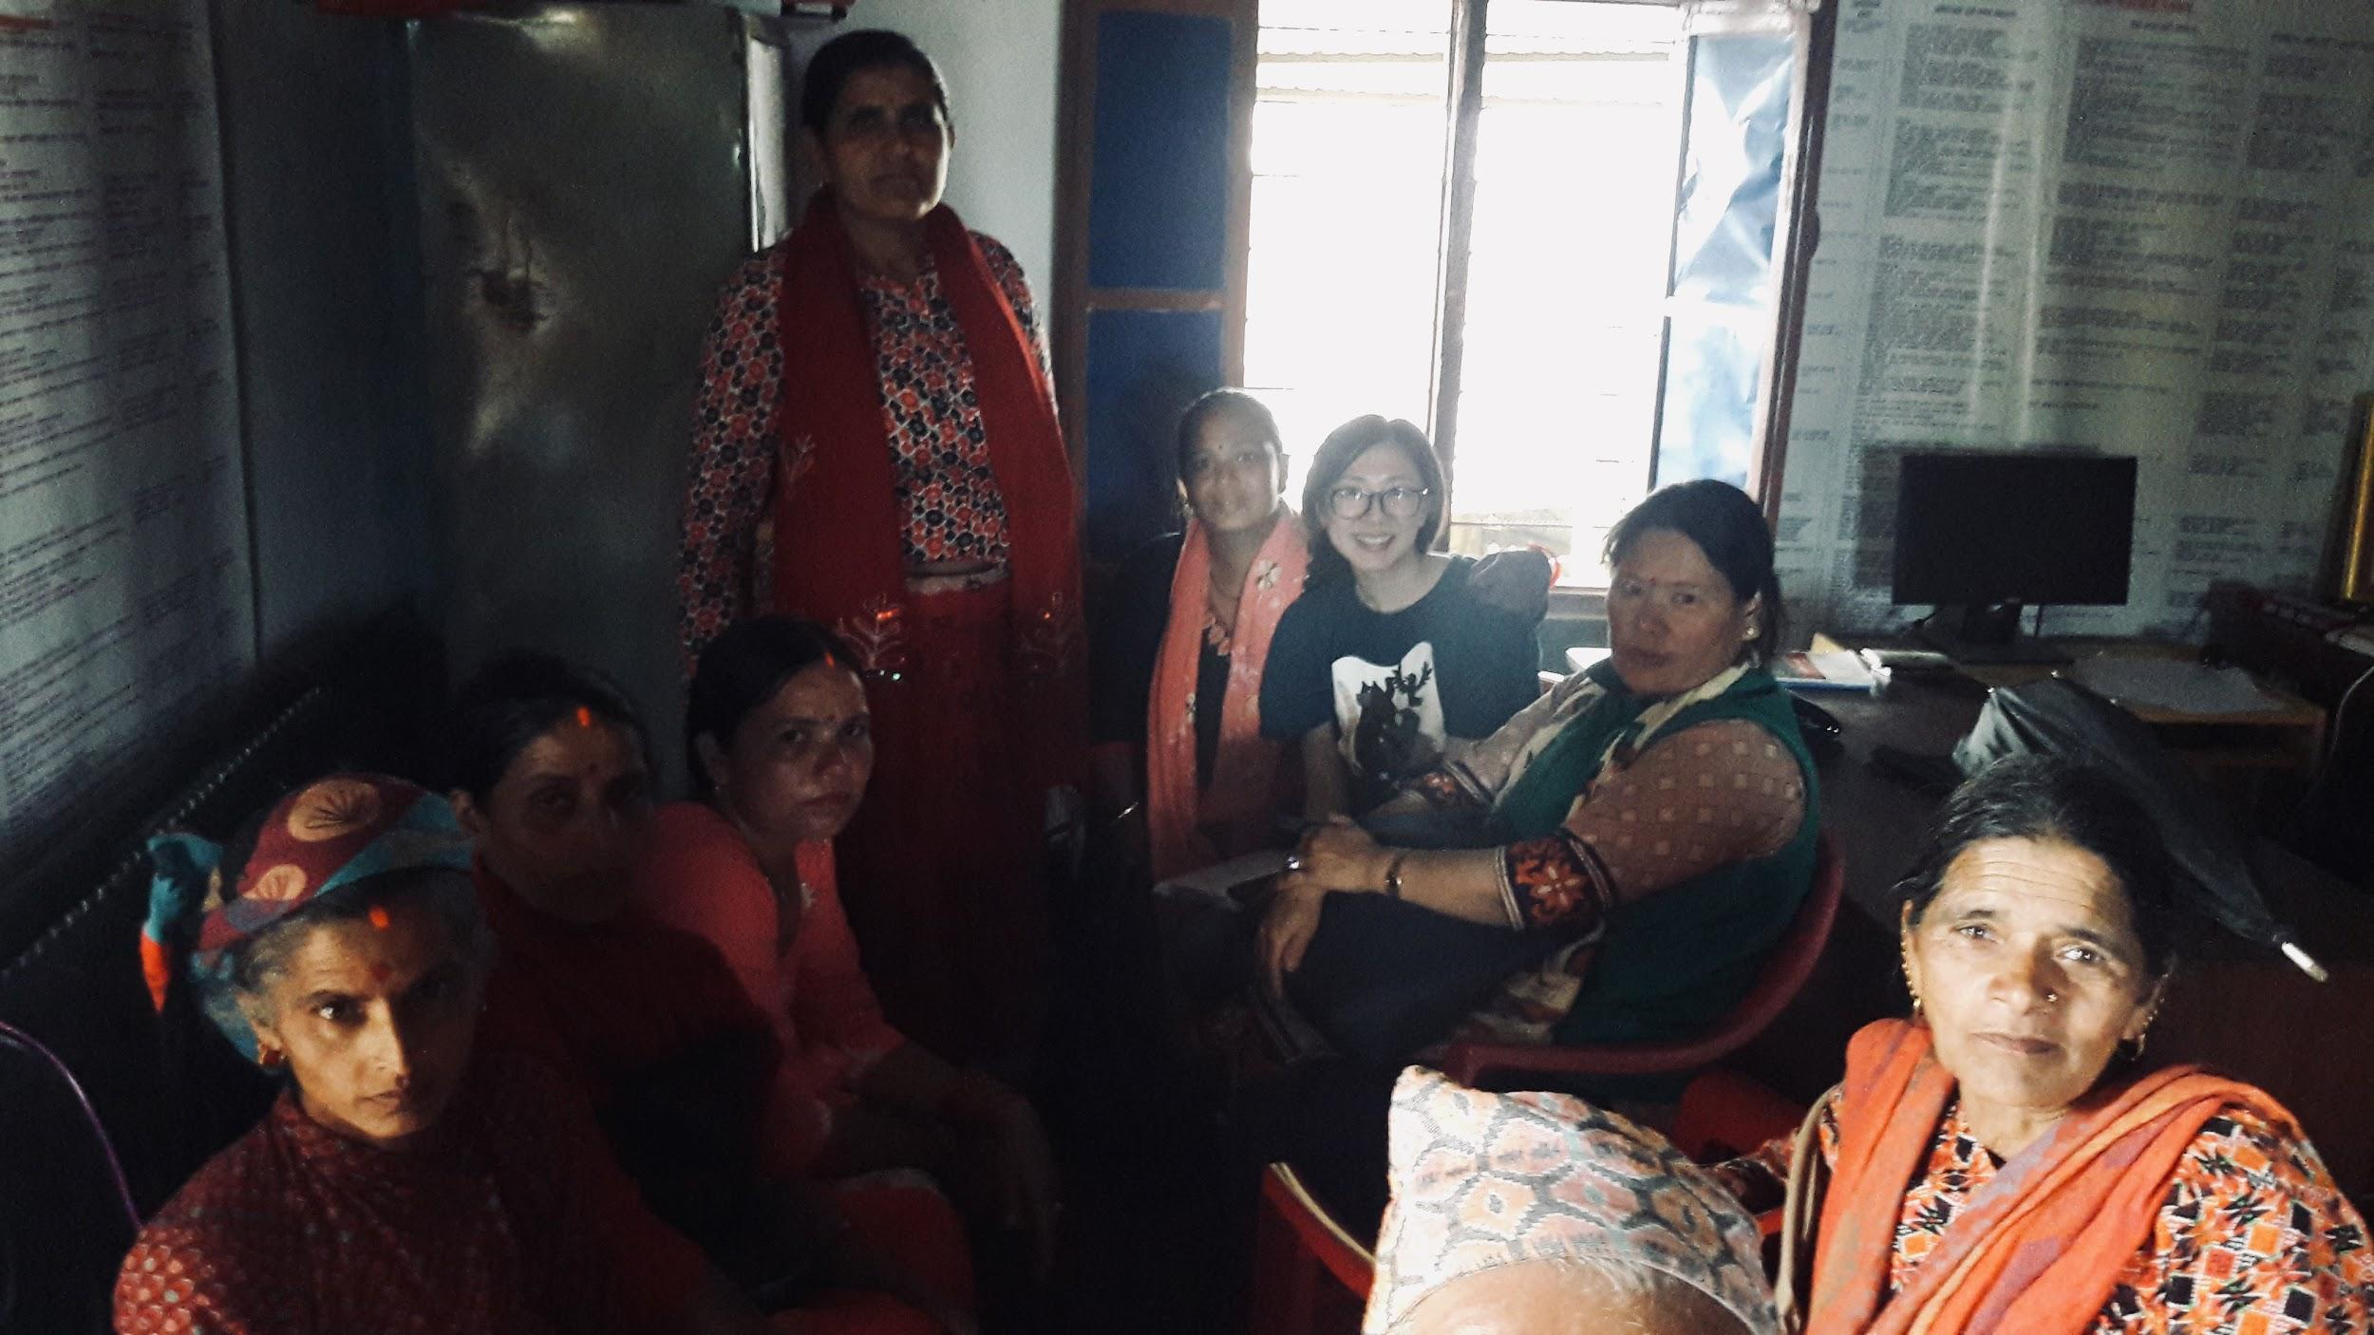
“we protested more than the men … The men were not trustworthy because they were easily bribed [by the company side]”
Focus group with women in affected community, Nepal (Image: Huang Zhong)

Slide 4
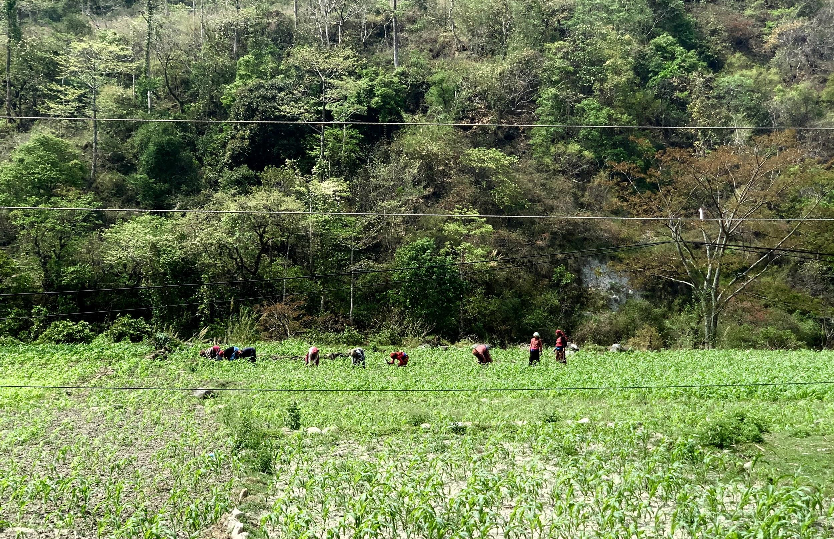
Good Practice: Empowering community women through local procurement
Women farming in the field, Nepal (image: Huang Zhong)

Slide 5
What are the lessons?

Slide 6
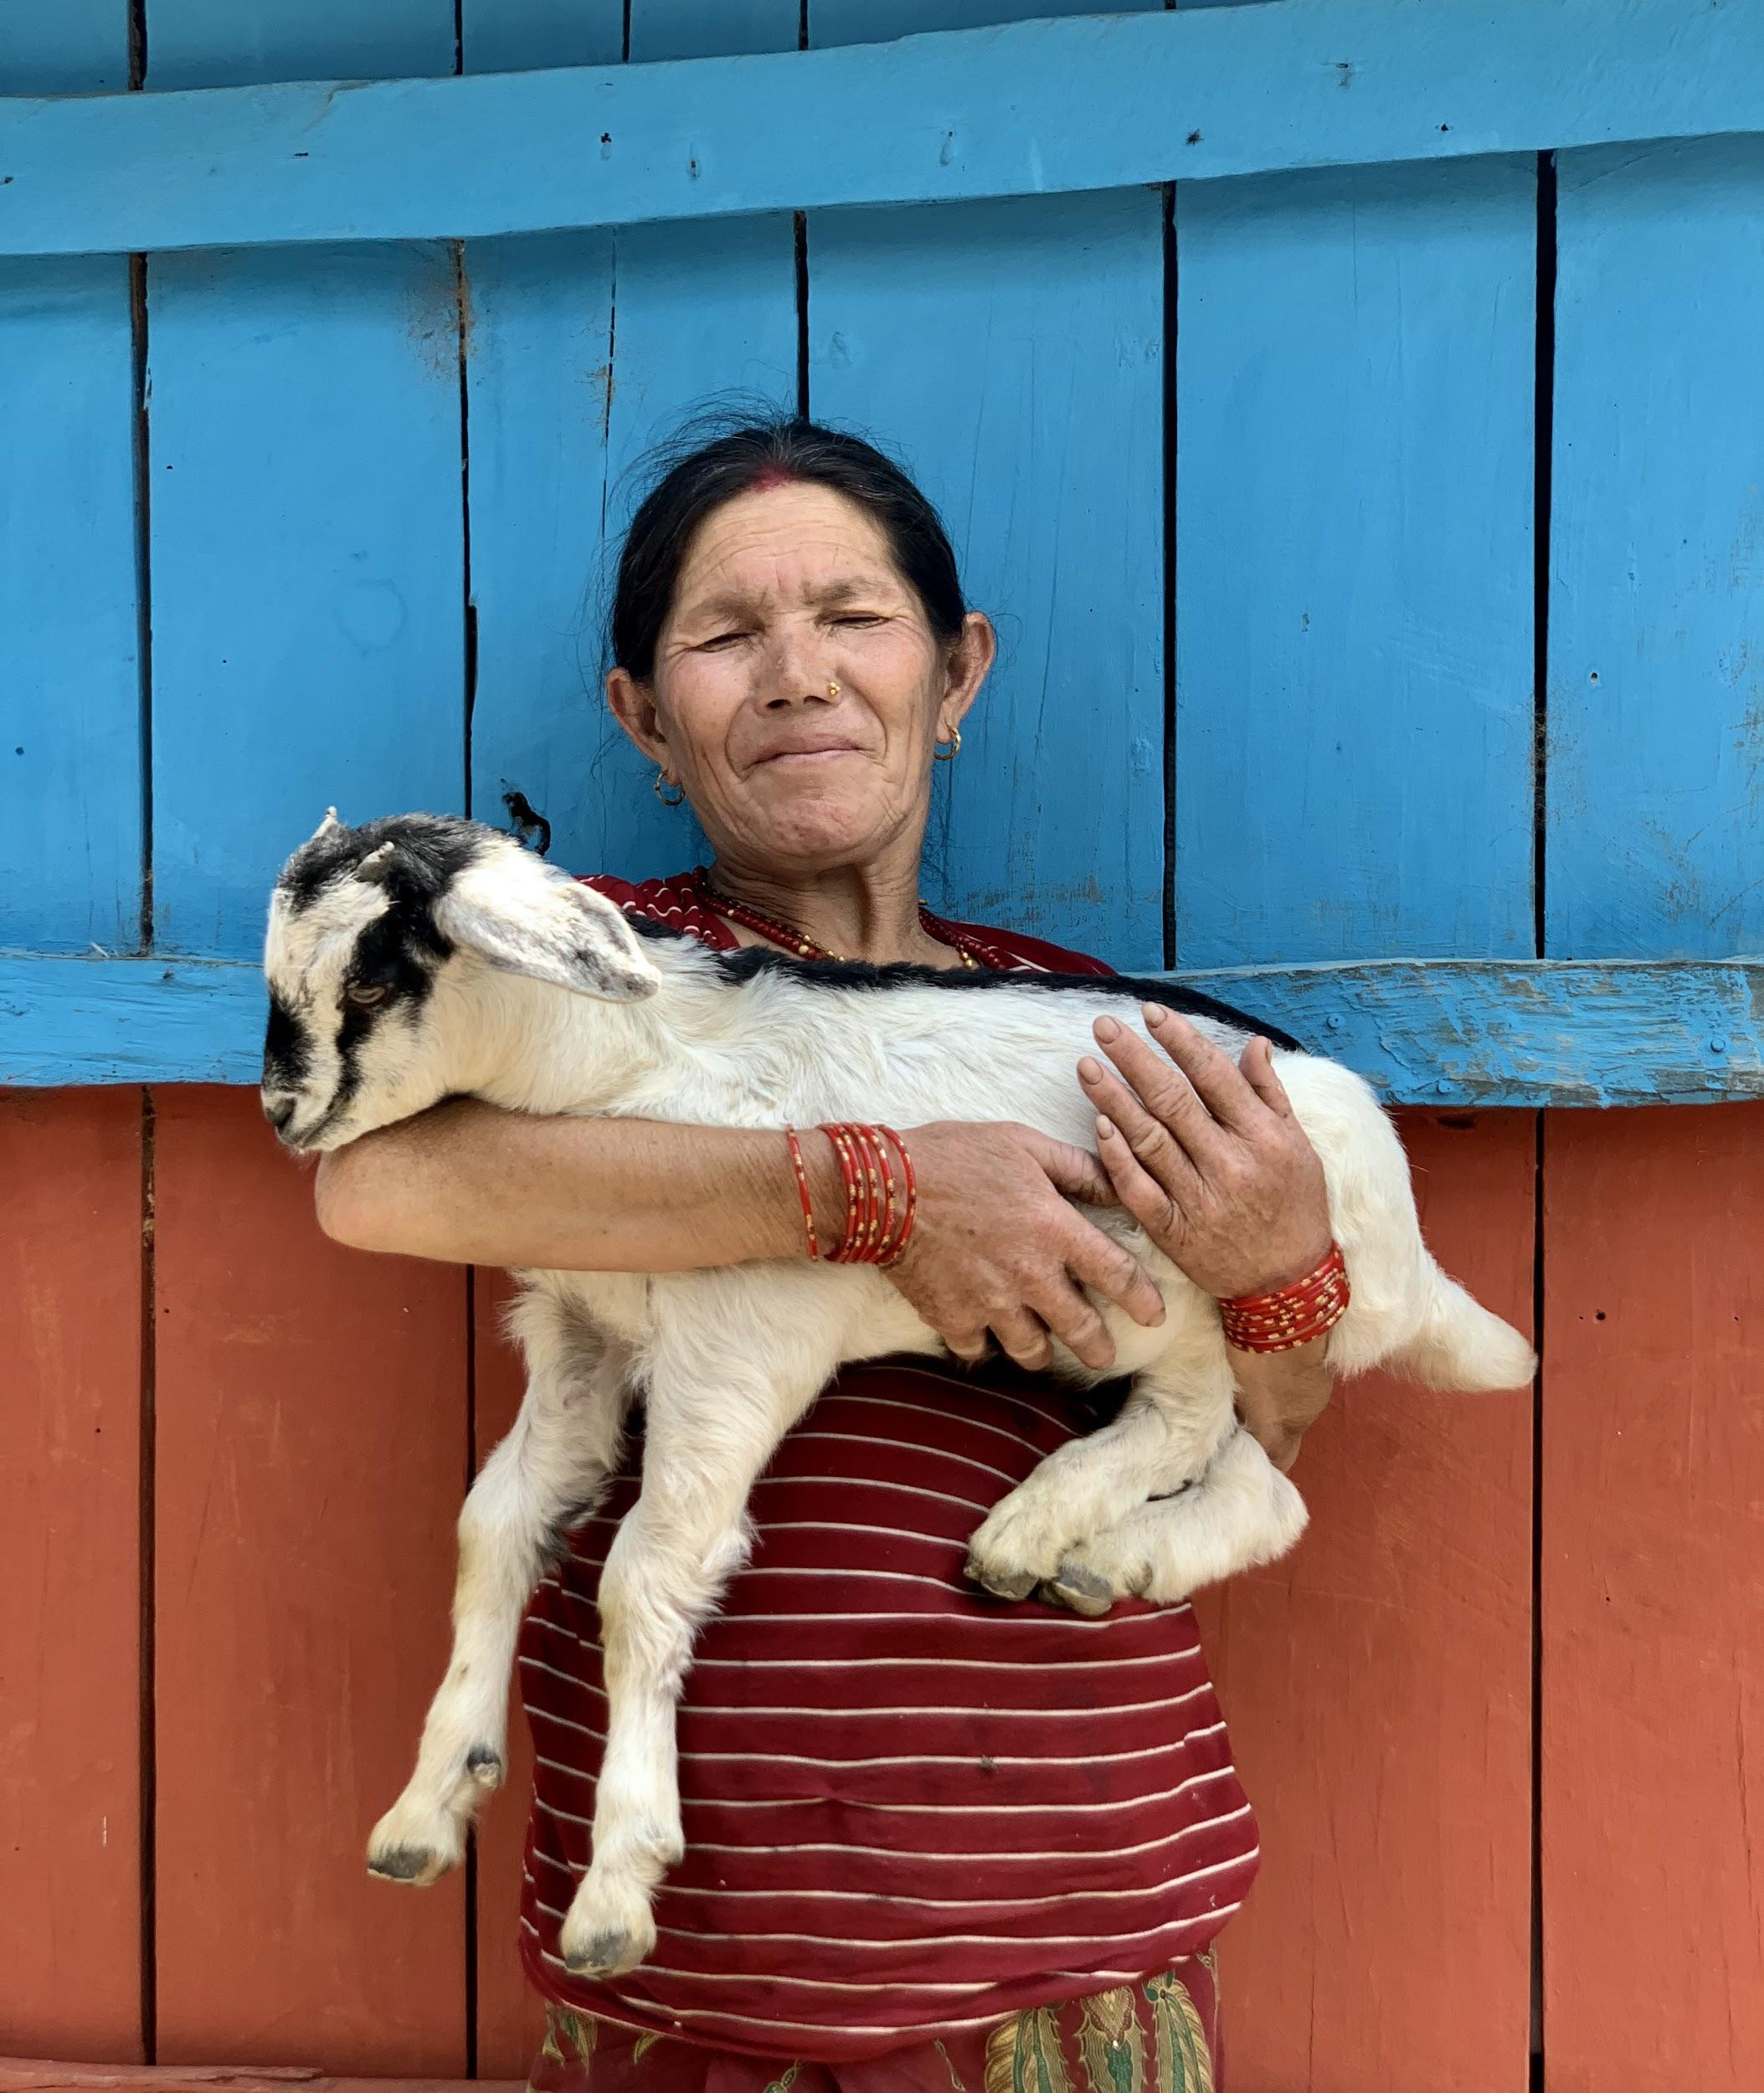
Gender impacts
Livelihood
Gendered roles
Public health and safety
Employment
Consultation and decision-making
Community woman with her lamb, Nepal (Image: Huang Zhong)

Slide 7
Urgent need to mainstream gender-responsive approach in ESG standards and impact assessment

Slide 8
Breaking stereotypes through evidence-based research

