Slide 1
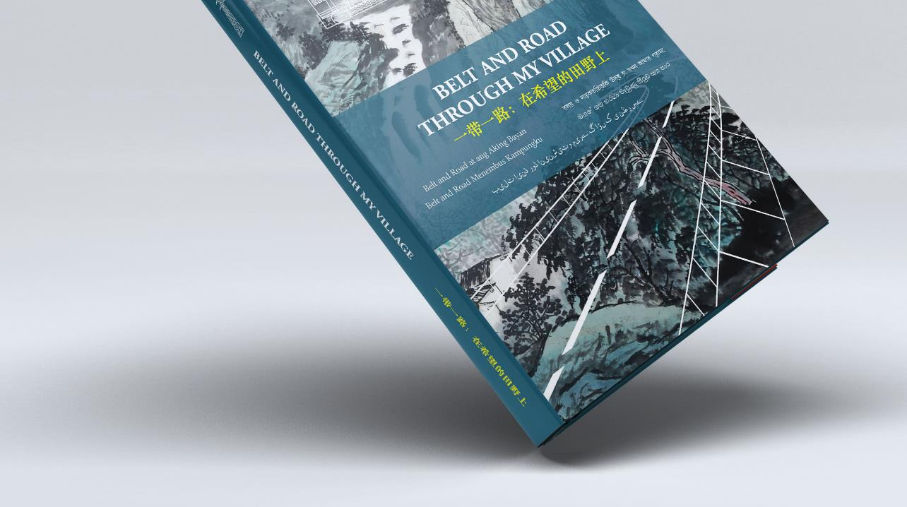
belt and road through my village

Slide 2
Bri ---- Brick? Bridge? A brick bridge.
Problem: Chinese companies do not respond to NGOs.
Goal: a dialogue starter between NGOs and Chinese stakeholders.
Audience: Chinese policy makers, investors.
Narrative: Out of the 5 BRI pillars, “P2P” connectivity is the weakest.
Tone: Balanced (good + bad, emotions + rationality, people + NGOs)
Output: a brick, a bridge, a visual story collection.
Uniqueness: voices from the most directly impacted communities.

Slide 3
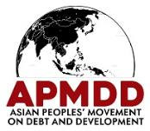
Project (June, 2019 ~ Oct, 2020)
7 projects (dam, road, railway, power, port city) in 5 countries:
Philippines, Indonesia, Bangladesh, Pakistan, Sri Lanka.
Total investment: about USD 25 billion dollars;
8 NGOs; 7 journalists; 20 volunteers; Over 100 villager; 7 languages;
www.BRIVillage.asia

Slide 4
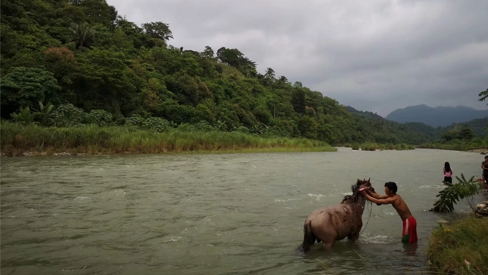
Villagers’ Voices – Philippines Kaliwa Dam (to be constructed)

Slide 5
Villagers’ Voices - Philippines
This place, which we inherited from our ancestors, is a gift that we must pass on to the future generation.
They sampled soil and rocks to test. No one came to us to explain.
If China is not seeing the financial risks or hearing the public opposition voices, it is likely because the Department of Energy of the Philippines is providing China with faulty information.

Slide 6
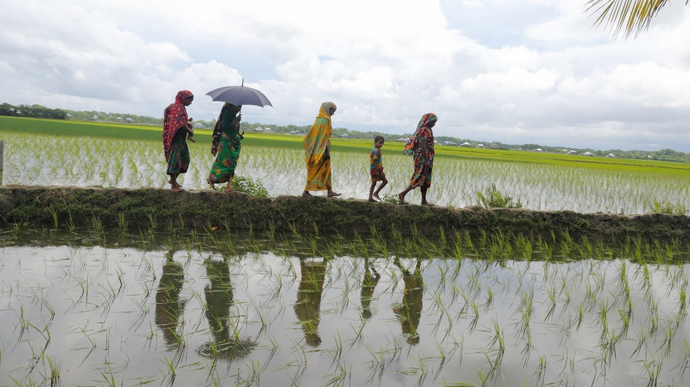
Villagers’ Voices – Bangladesh Taltoli 350 MW coal power plant (under construction)

Slide 7
Villagers’ Voices – Bangladesh
My daughter, Khukumoni, is 13 years old. Last year, we had to marry her off due to poverty and fear.
My final examination will start this week. I can study well at night.
It is crucial to get uninterrupted electric supply in banks, hospitals, and factories. As a nation, we proudly believe Bangladesh will move forward in prosperity.

Slide 8
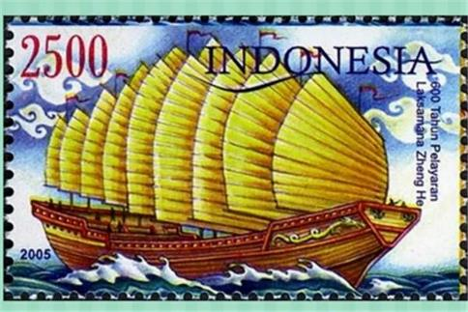
Stakeholder engagement (Oct, 2020 ~ present)
Chinese embassies, chambers of commerce, industry associations, in 5 countries;
Local government agencies in 5 host countries;
Chinese thinktanks on BRI; Media and Chinese NGOs;
Chinese companies involved, and not involved, inside China.
It’s a reputational, as well as an investment, risk for China.

Slide 9
Reactions: business + politics
Chinese companies:
Development comes with a cost;
Blame host countries’ needs, it’s a business for China.
low trust in int’l NGOs but Chinese NGOs can be a bridge.
Chinese Embassies and local gov’t: no public comment or direct reaction; but there have been progresses on the projects.
Chinese thinktanks: Chinese NGOs have a BRIDGE role to play;

Slide 10
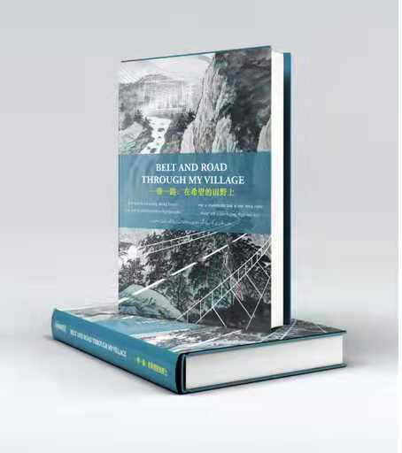
Lessons:
Chinese culture, politics, mentality, language, context.
Emotions alone do not work. Talk business, money, politics, and reputation.
Forward-looking with constructive criticism;
Authentic grassroots voices from local thinktanks, KOLs, and NGOs.
x DO NOT SHIP BOOKS DURING A PANDEMIC…

